Slide 1
Imagination League Entries
6 Steps to Inspire Student Innovation
Simplify Language and Use Age-Appropriate Terms: Use straightforward language that younger participants can easily understand. For example, instead of “innovation project,” say “your idea to help others.”
Provide Encouragement and Emphasize Fun: Include motivational phrases like “Have fun with your ideas!” or “Show us your creativity!” Emphasize the opportunity for participants to be creative and make a difference in an exciting way: “Your idea could make the world a better place!”
Outline Steps in a Simple Checklist Format: Break down steps into a checklist format. For instance:
  Choose a challenge.
  Think of your solution.
  Describe or draw your idea.
  Submit your entry by Friday, December 12, 2025.
Give Specific Examples and Suggestions: Help participants brainstorm with examples. “For example, if you choose the ‘Clean Water’ challenge, you could come up with ways to save water in your neighborhood or make it easier for people to have clean water.”
Clarify Submission Requirements Briefly: Provide students with a clear understanding of the Sustainable Development Goals (SDGs) and each challenge. Share customer profiles to help them identify who their idea could help and inspire solutions for real-world impact.
Reinforce Positive Learning Outcomes: Reinforce that the experience is about learning and growth. “This challenge helps you practice thinking about problems and coming up with solutions – just like an inventor!”

Slide 2
See How It’s Done
A Sample Entry
Before you start your own big idea, look at how one student filled out the form!
This sample entry walks through each question step-by-step. You'll see:
A specific person the student wanted to help
A clear explanation of the problem
A fun, creative idea to solve it
How the idea would work in real life
💡 Remember: This is just one example. Your idea can and WILL look totally different!

Slide 3



Who are you trying to help?
Draw or write your answers here:
I want to help kids like me who live in rainy places and don’t have a lot of space at home to play.
Is it your classmates, your teacher, your family, your friends, or maybe even people you don’t know yet?
Think about someone who could use a little help or a big change!
Mark
8 years old
Lives in New York City
Likes to play and run around
Has 2 brothers and 1 sister at home.
DID YOU:
Pick a specific person or group (not just everyone)?
Imagine what they look like or do in real life?
Powered by NFTE | Official WSI Imagination League Entry Form

Slide 4
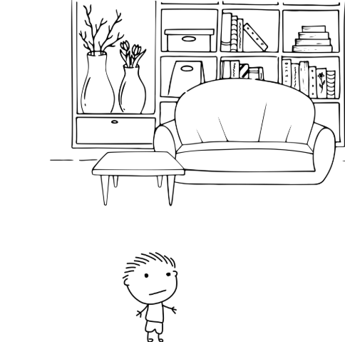
What problem are they having
Draw or write your answers here:
Think about the person you are helping.
What’s making things harder for them?
Is something missing, unfair, confusing, or just not working right?
DID YOU:
Explain what makes things hard for the person?
Give 1 example of the problem?
When the it rains or is it too hot outside, we have no room inside to play.
Powered by NFTE | Official WSI Imagination League Entry Form

Slide 5
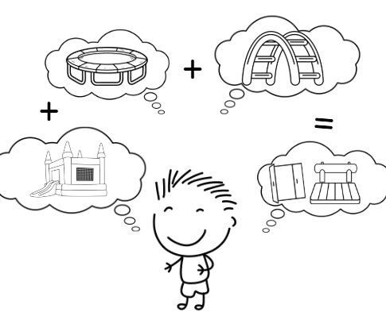
What is your idea?
Draw or write your answers here:
What awesome idea do you have to solve this problem?
Your idea can be anything—something new you invent, a way to make something better, or even a fun activity or place
Can you do something creative with your idea to help the person solve their problem?
DID YOU:
Think about how this helps someone feel better or do something easier?
Draw, write, or show what your idea is?
Powered by NFTE | Official WSI Imagination League Entry Form

Slide 6
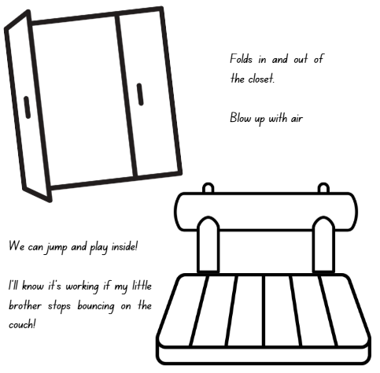
How Will Your Idea Work?
Draw or write your answers here:
Tell us how people would use your idea and what it does.
What steps can you take to make your solution work?
What are the first few things you need to start your idea?
How will you know if your solution is working?
A play place that fits in the closet!
Gets bigger by filling up with air.
We will have space to play and move around indoors.
It is working if my little brother stops bouncing on the couch
DID YOU:
Explain what happens when someone uses or idea?
Powered by NFTE | Official WSI Imagination League Entry Form

Slide 7
Official WSI Imagination League
Entry Form
We are so excited you are here! You have big ideas, and we can’t wait to see how you will use them to help others and make the world a better place.
Let’s Get Started!
Feel free to draw pictures, write in pencil or pen, or type if preferred.
There are four questions to answer.
There’s no right or wrong idea, just share your thinking and creativity!
Innovation Name:
Team Member Names:
Please remember to have a teacher or guardian submit your entry by Friday, December 12, 2025!

Slide 8
Who are you trying to help? | What problem are they having?
Powered by NFTE | Official WSI Imagination League Entry Form

Slide 9
What is your idea? | How will your idea work?
Powered by NFTE | Official WSI Imagination League Entry Form

Slide 10
Entry Check List: Get Ready to Submit
Before you send in your idea, make sure you’ve got all the pieces! Use this checklist to help you double-check your entry.
🔲 I chose someone I want to help.
🔲 I described the problem they’re facing.
🔲 I came up with a creative idea to solve it.
🔲 I explained how my idea would work.
🔲 I drew or wrote out my answers.
🔲 I came up with a name for my idea.
🔲 I had fun sharing my imagination!
🔲 My entry is ready to be submitted by Friday, December 12, 2025!

